Slide 1
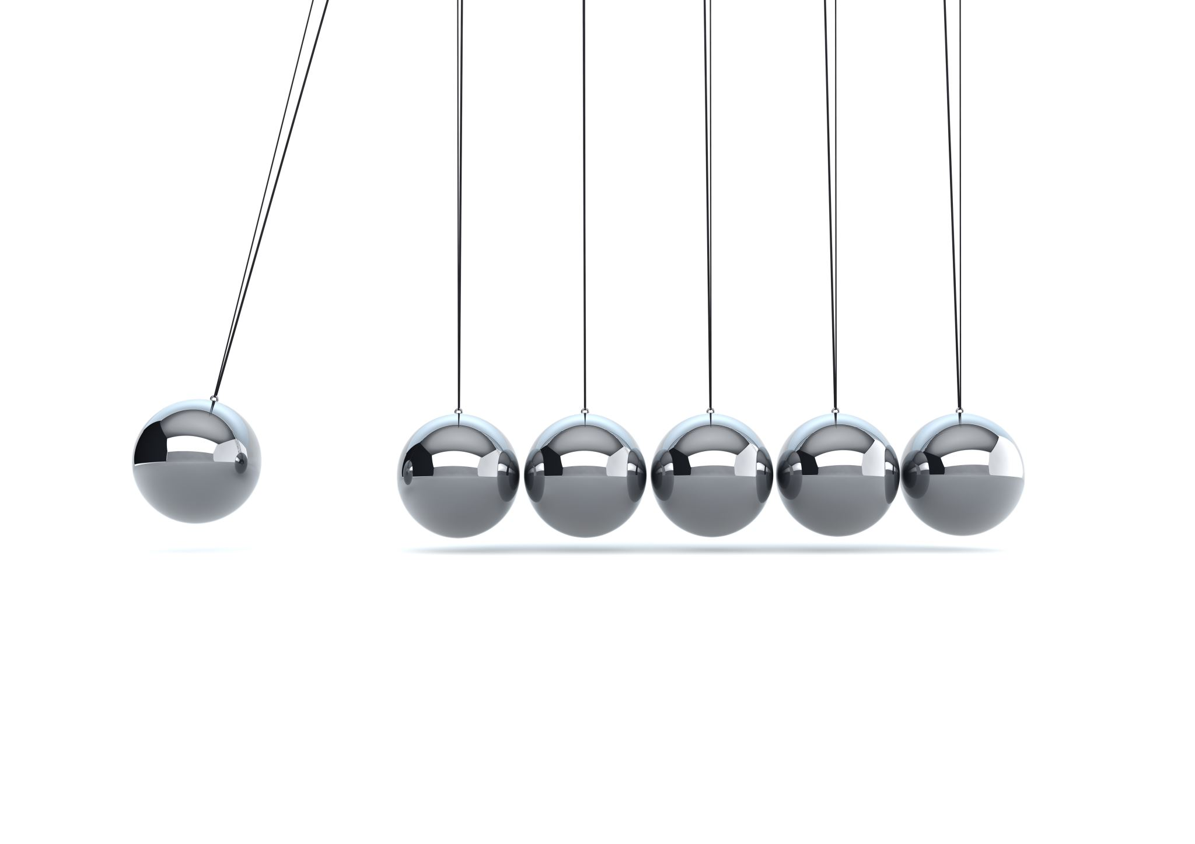
Kapitza Pendulum Project
Neil Ghugare
Physics 5300 – Autumn 2025

Slide 2
History
Rigid pendulum with vertically-vibrating pivot point.
1951: Russian Nobel laureate Pyotr Kapitza.
Multiple interesting and unusual properties.

Slide 3
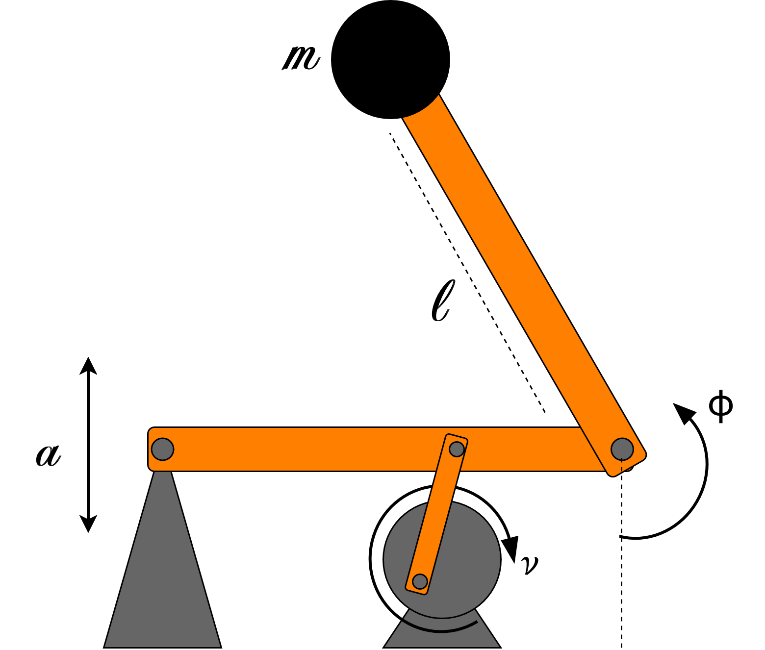
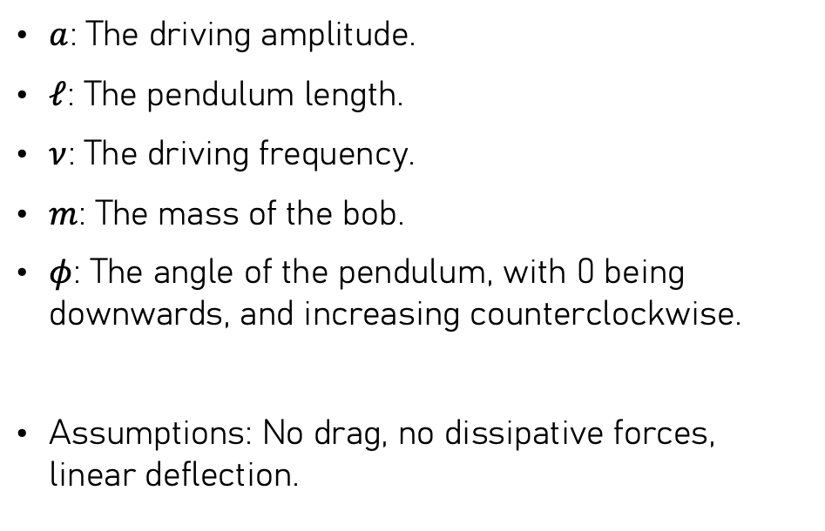
The System
$a$: The driving amplitude.
$ℓ$: The pendulum length.
$ν$: The driving frequency.
$m$: The mass of the bob.
$φ$: The angle of the pendulum, with 0 being downwards, and increasing counterclockwise.
Assumptions: No drag, no dissipative forces, linear deflection.

Slide 4
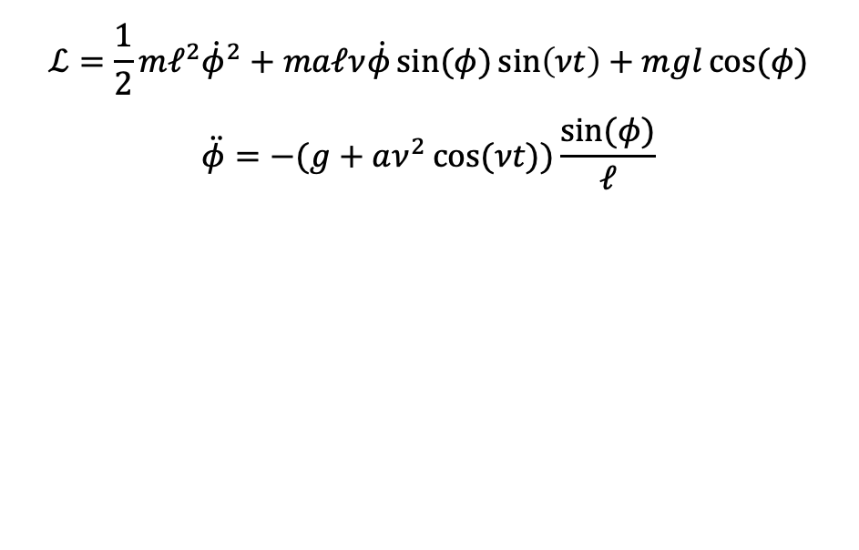
Lagrangian and EoM
$$ℒ=\frac{1}{2}mℓ^{2}{\dot{φ}}^{2}+maℓν\dot{φ}\sin{(φ)}\sin\left(νt\right)+mgl\cos{(φ)}$$
$$\ddot{φ}=−(g+aν^{2}\cos{(νt))\frac{\sin{(φ)}}{ℓ}}$$

Slide 5
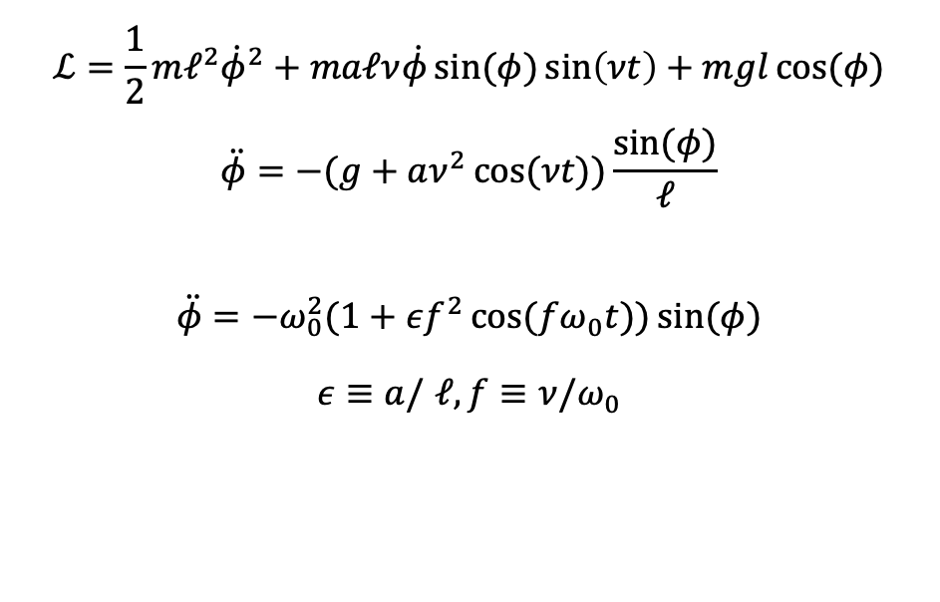
Lagrangian and EoM
$$ℒ=\frac{1}{2}mℓ^{2}{\dot{φ}}^{2}+maℓν\dot{φ}\sin{(φ)}\sin\left(νt\right)+mgl\cos{(φ)}$$
$$\ddot{φ}=−(g+aν^{2}\cos{(νt))\frac{\sin{(φ)}}{ℓ}}$$
$$\ddot{φ}=−ω_{0}^{2}(1+εf^{2}\cos{(fω_{0}t))\sin{(φ)}}$$
$ε≡a/$ $ℓ,f≡ν/ω_{0}$

Slide 6
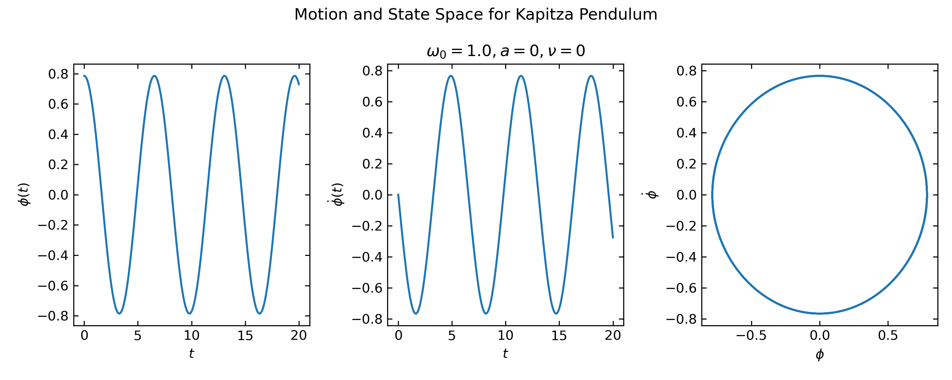

Slide 7
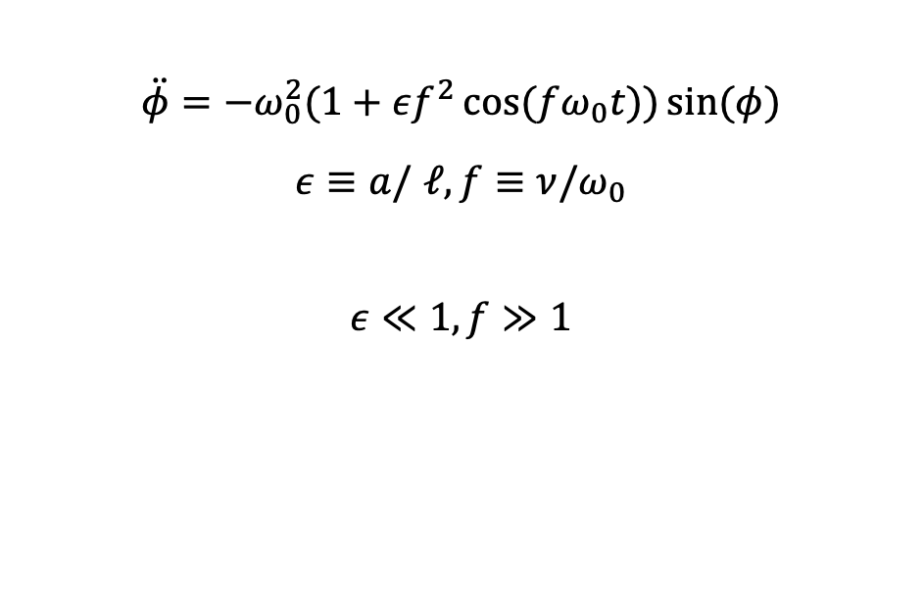
High-Driving, Low Amplitude Regime
$$\ddot{φ}=−ω_{0}^{2}(1+εf^{2}\cos{(fω_{0}t))\sin{(φ)}}$$
$ε≡a/$ $ℓ,f≡ν/ω_{0}$
$$ε≪1,f≫1$$

Slide 8
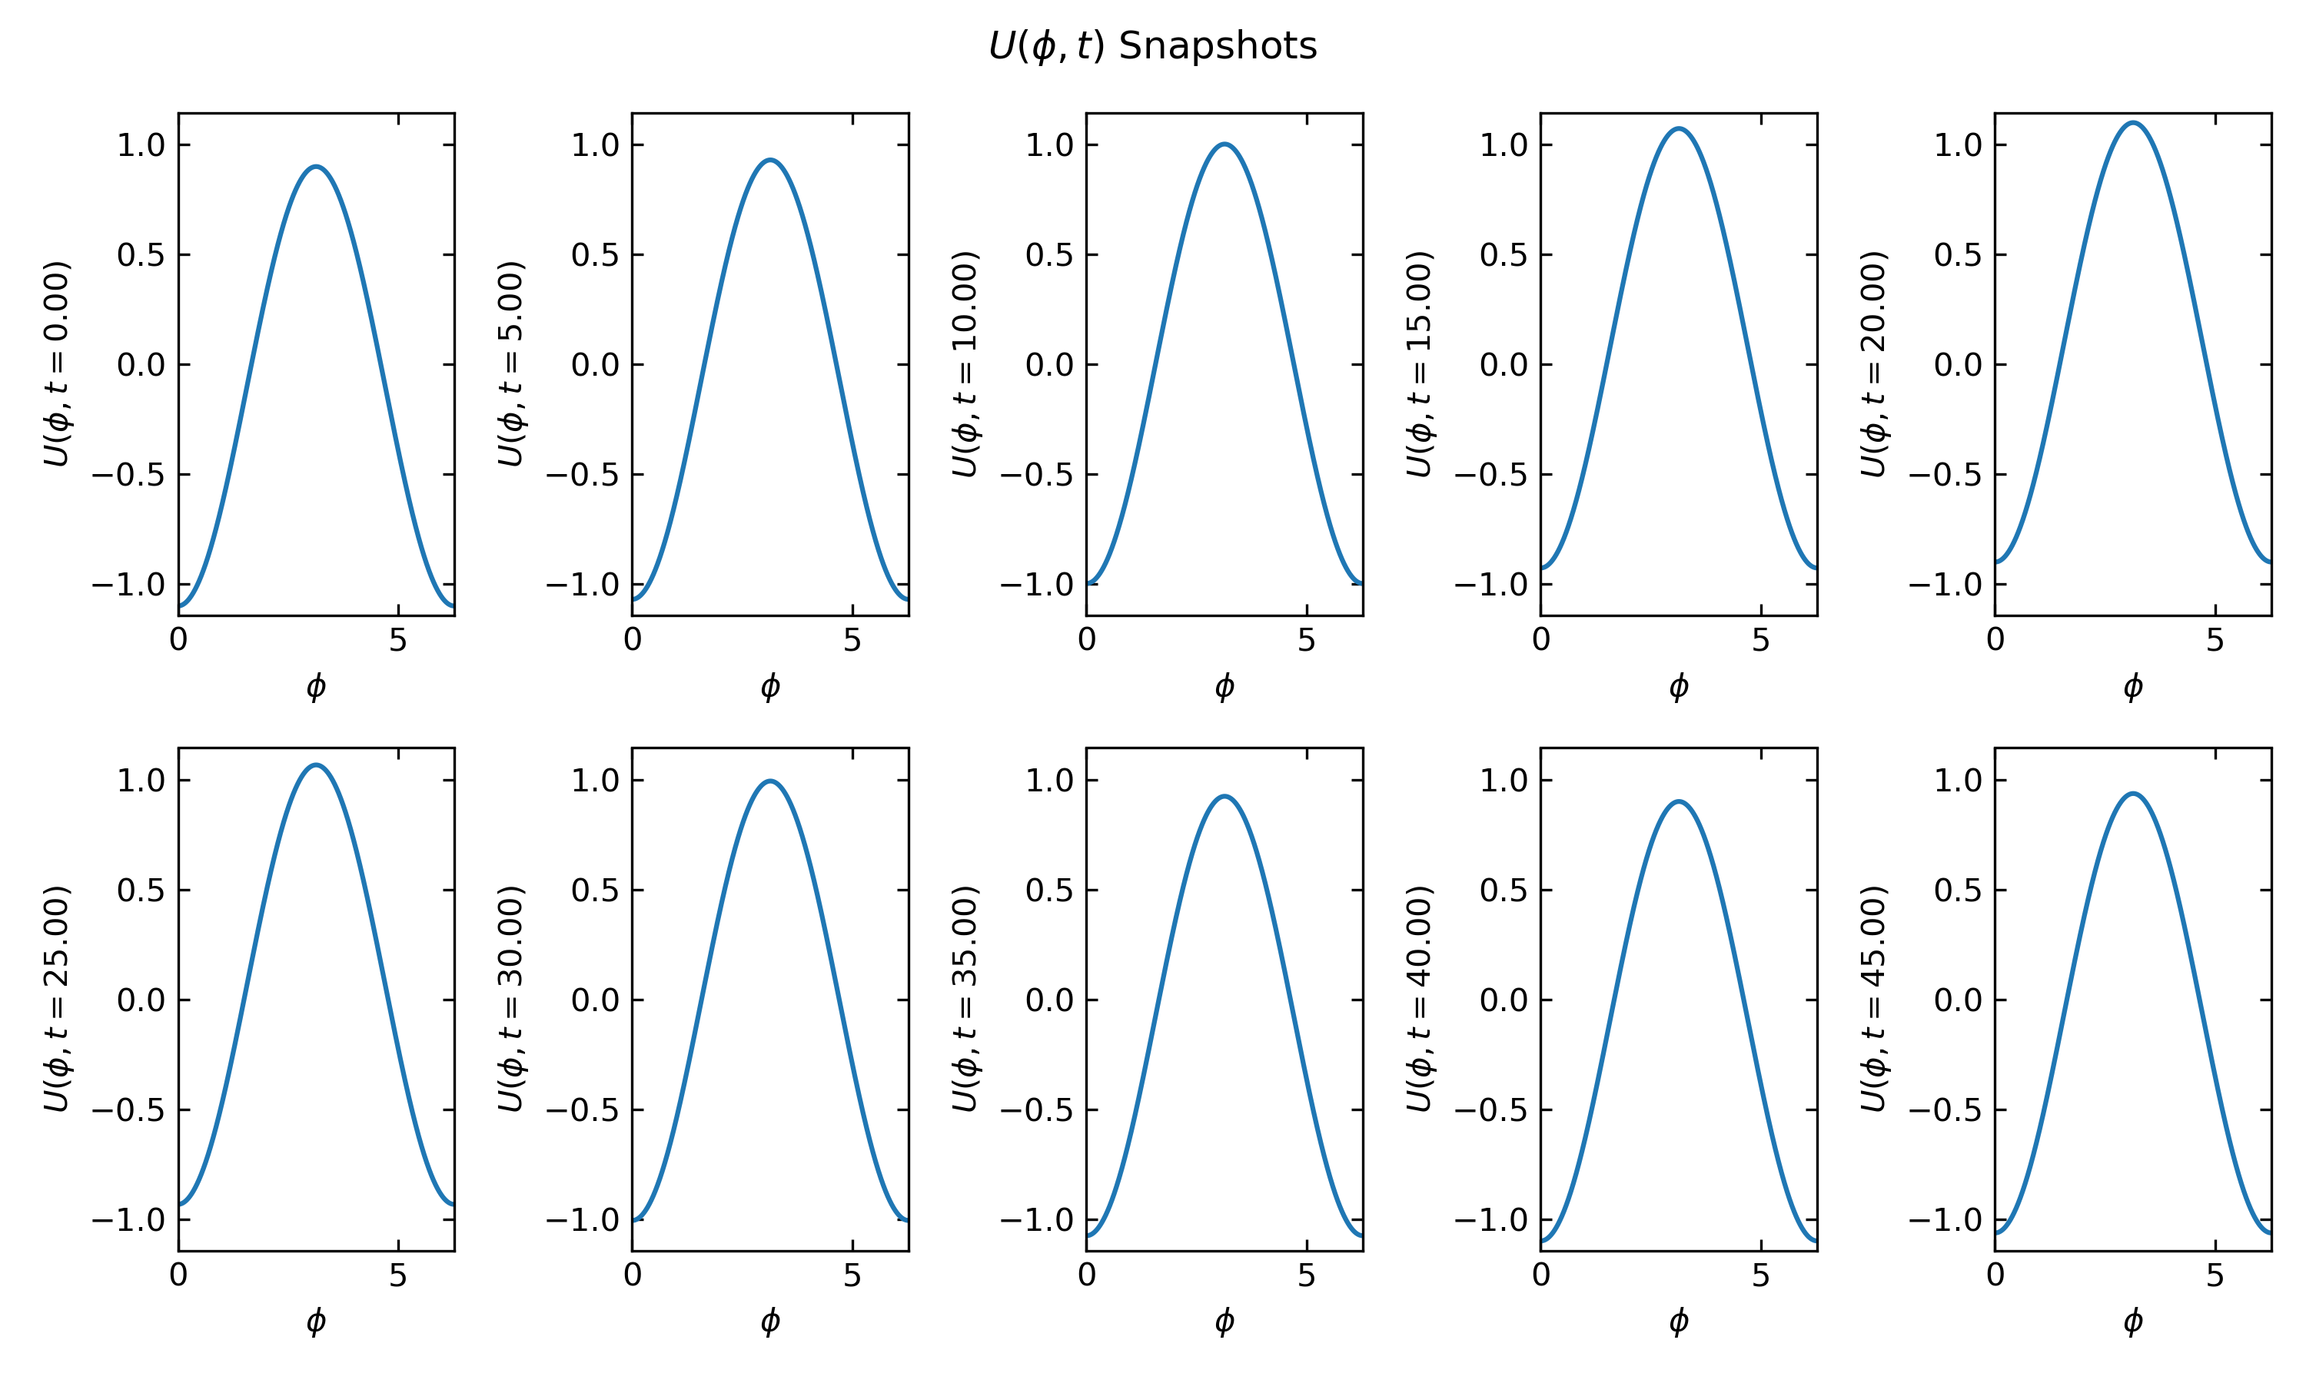

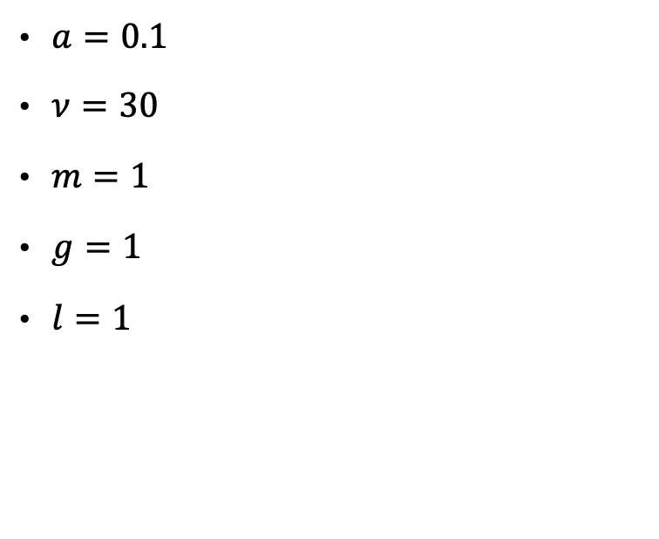
$$U\left(φ,t\right)=−mg(l\cos\left(φ\right)+a\cos\left(νt\right))$$
$a=0.1$
$ν=30$
$m=1$
$g=1$
$l=1$

Slide 9
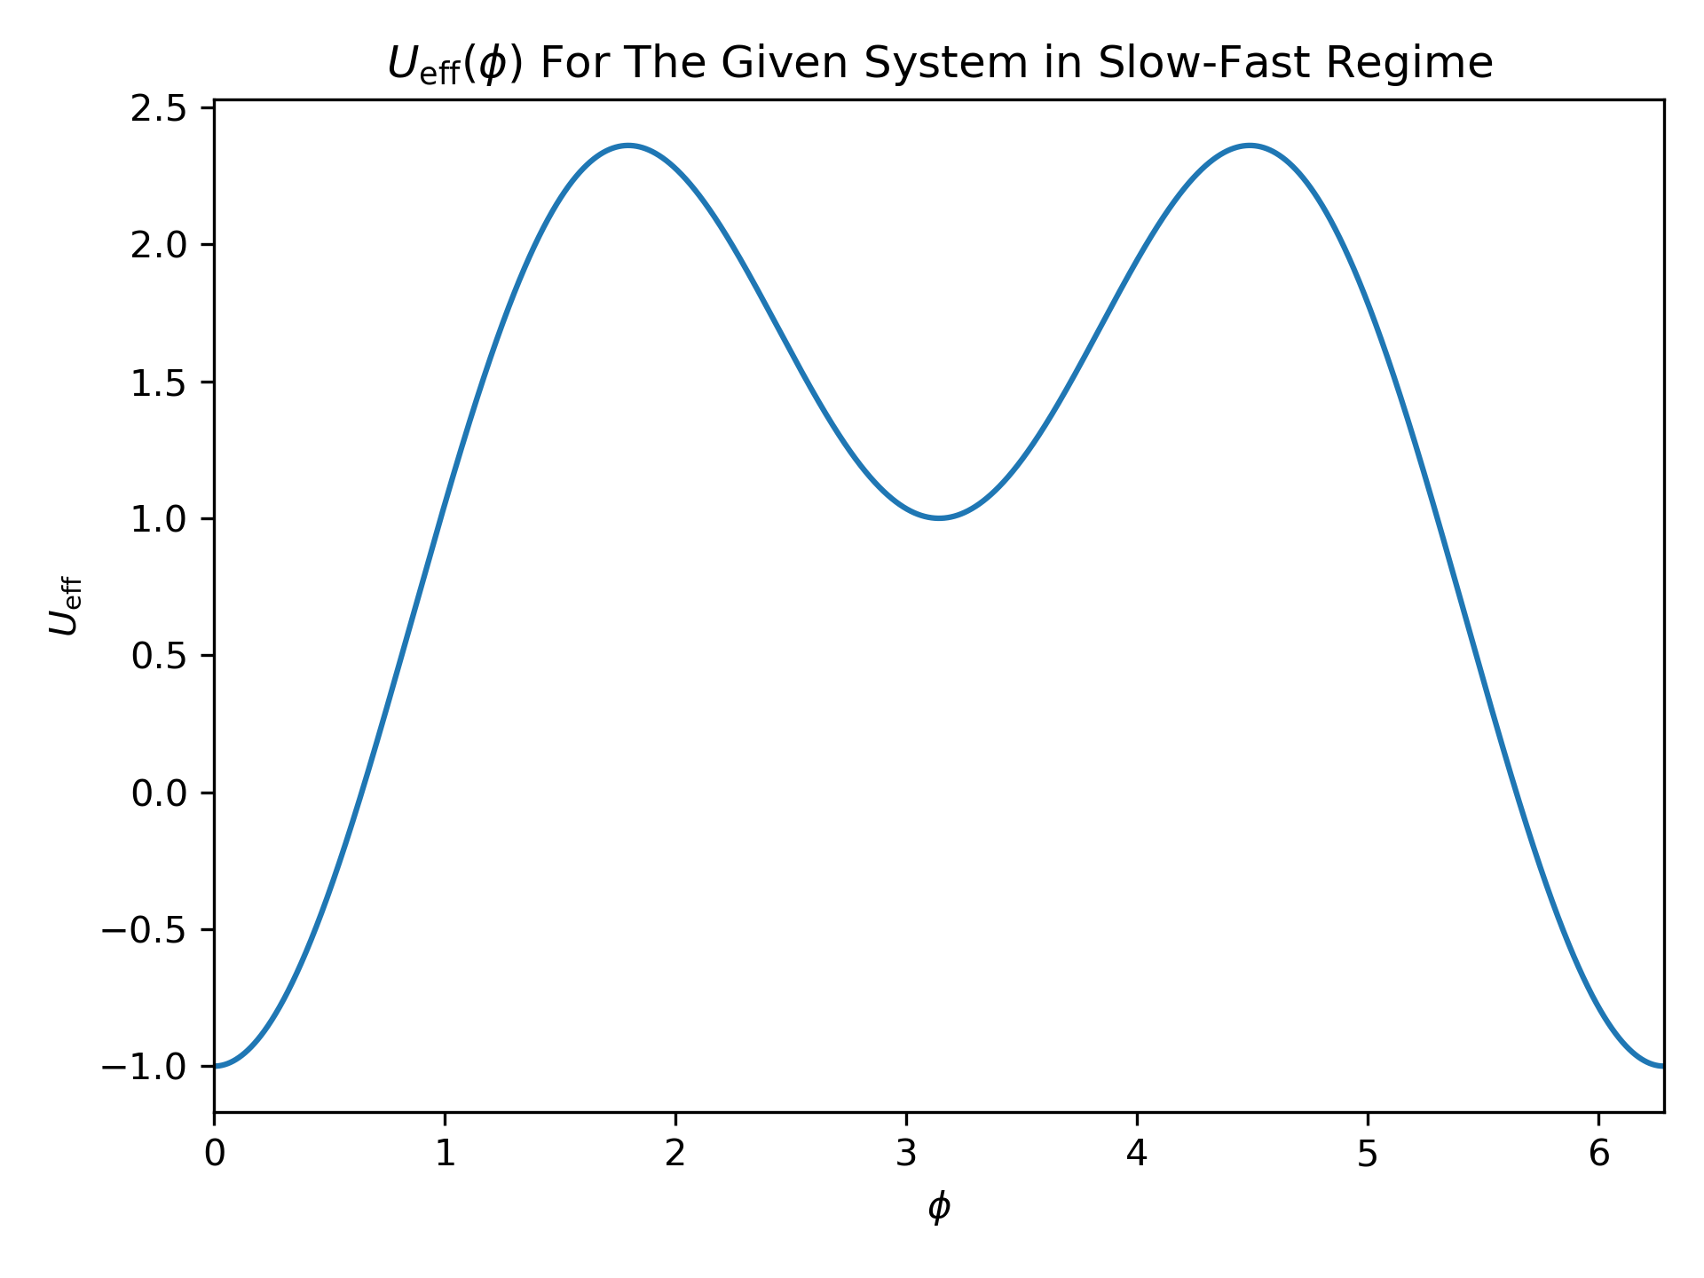

$$U_{eff}\left(φ\right)≈−mgl\cos\left(φ\right)+\frac{ma^{2}ν^{2}}{4}\sin^{2}{(φ)}$$
Effective potential for the high-driving, low-amplitude regime.
Derivation part of project.
Fast-slow decomposition of motion.

Slide 10
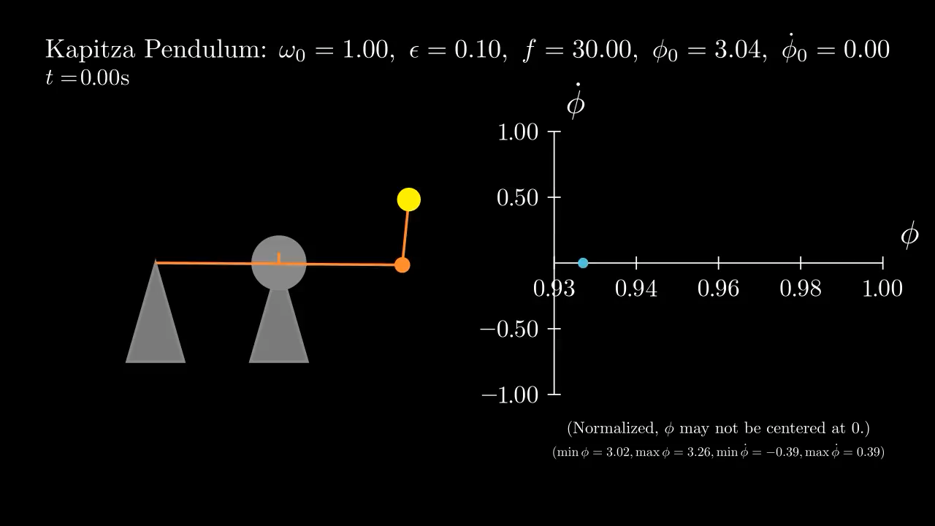

Slide 11
How Does the Amplitude Impact Stability?
Chaos and bifurcation analysis of the system.

Slide 12
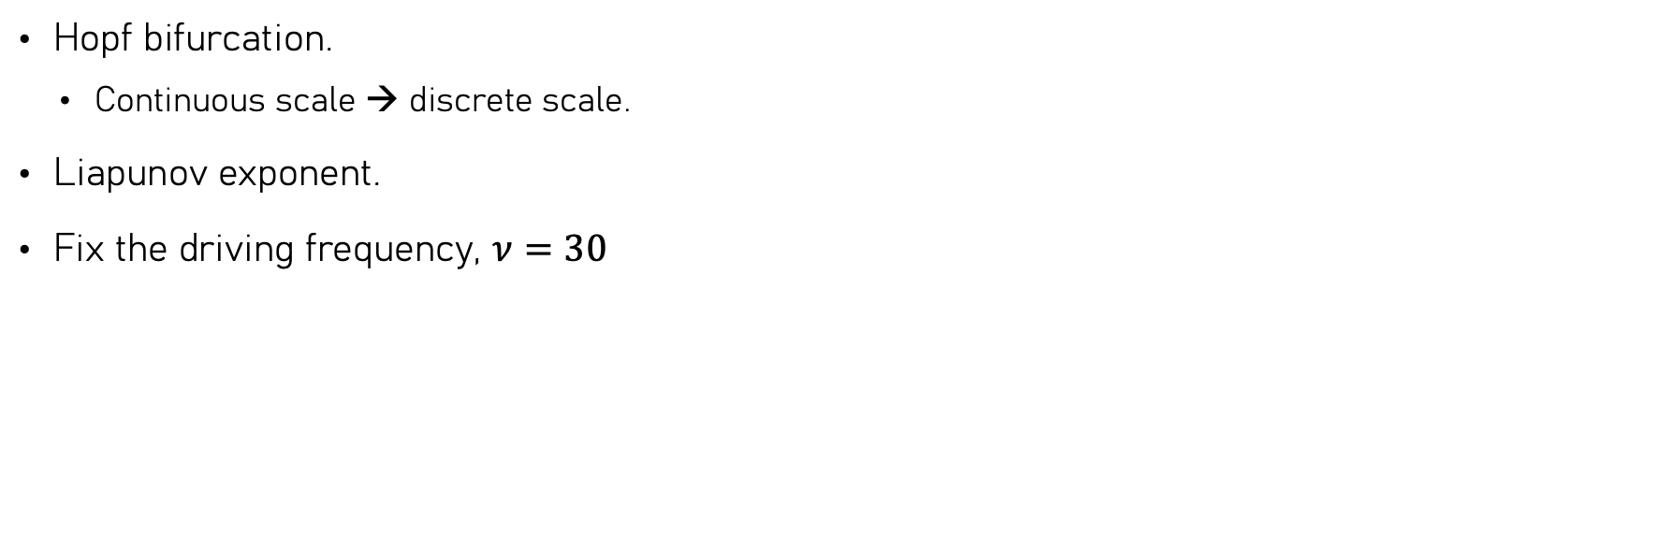
How Do We Tackle This?
Hopf bifurcation.
Continuous scale → discrete scale.
Liapunov exponent.
Fix the driving frequency, $ν=30$

Slide 13
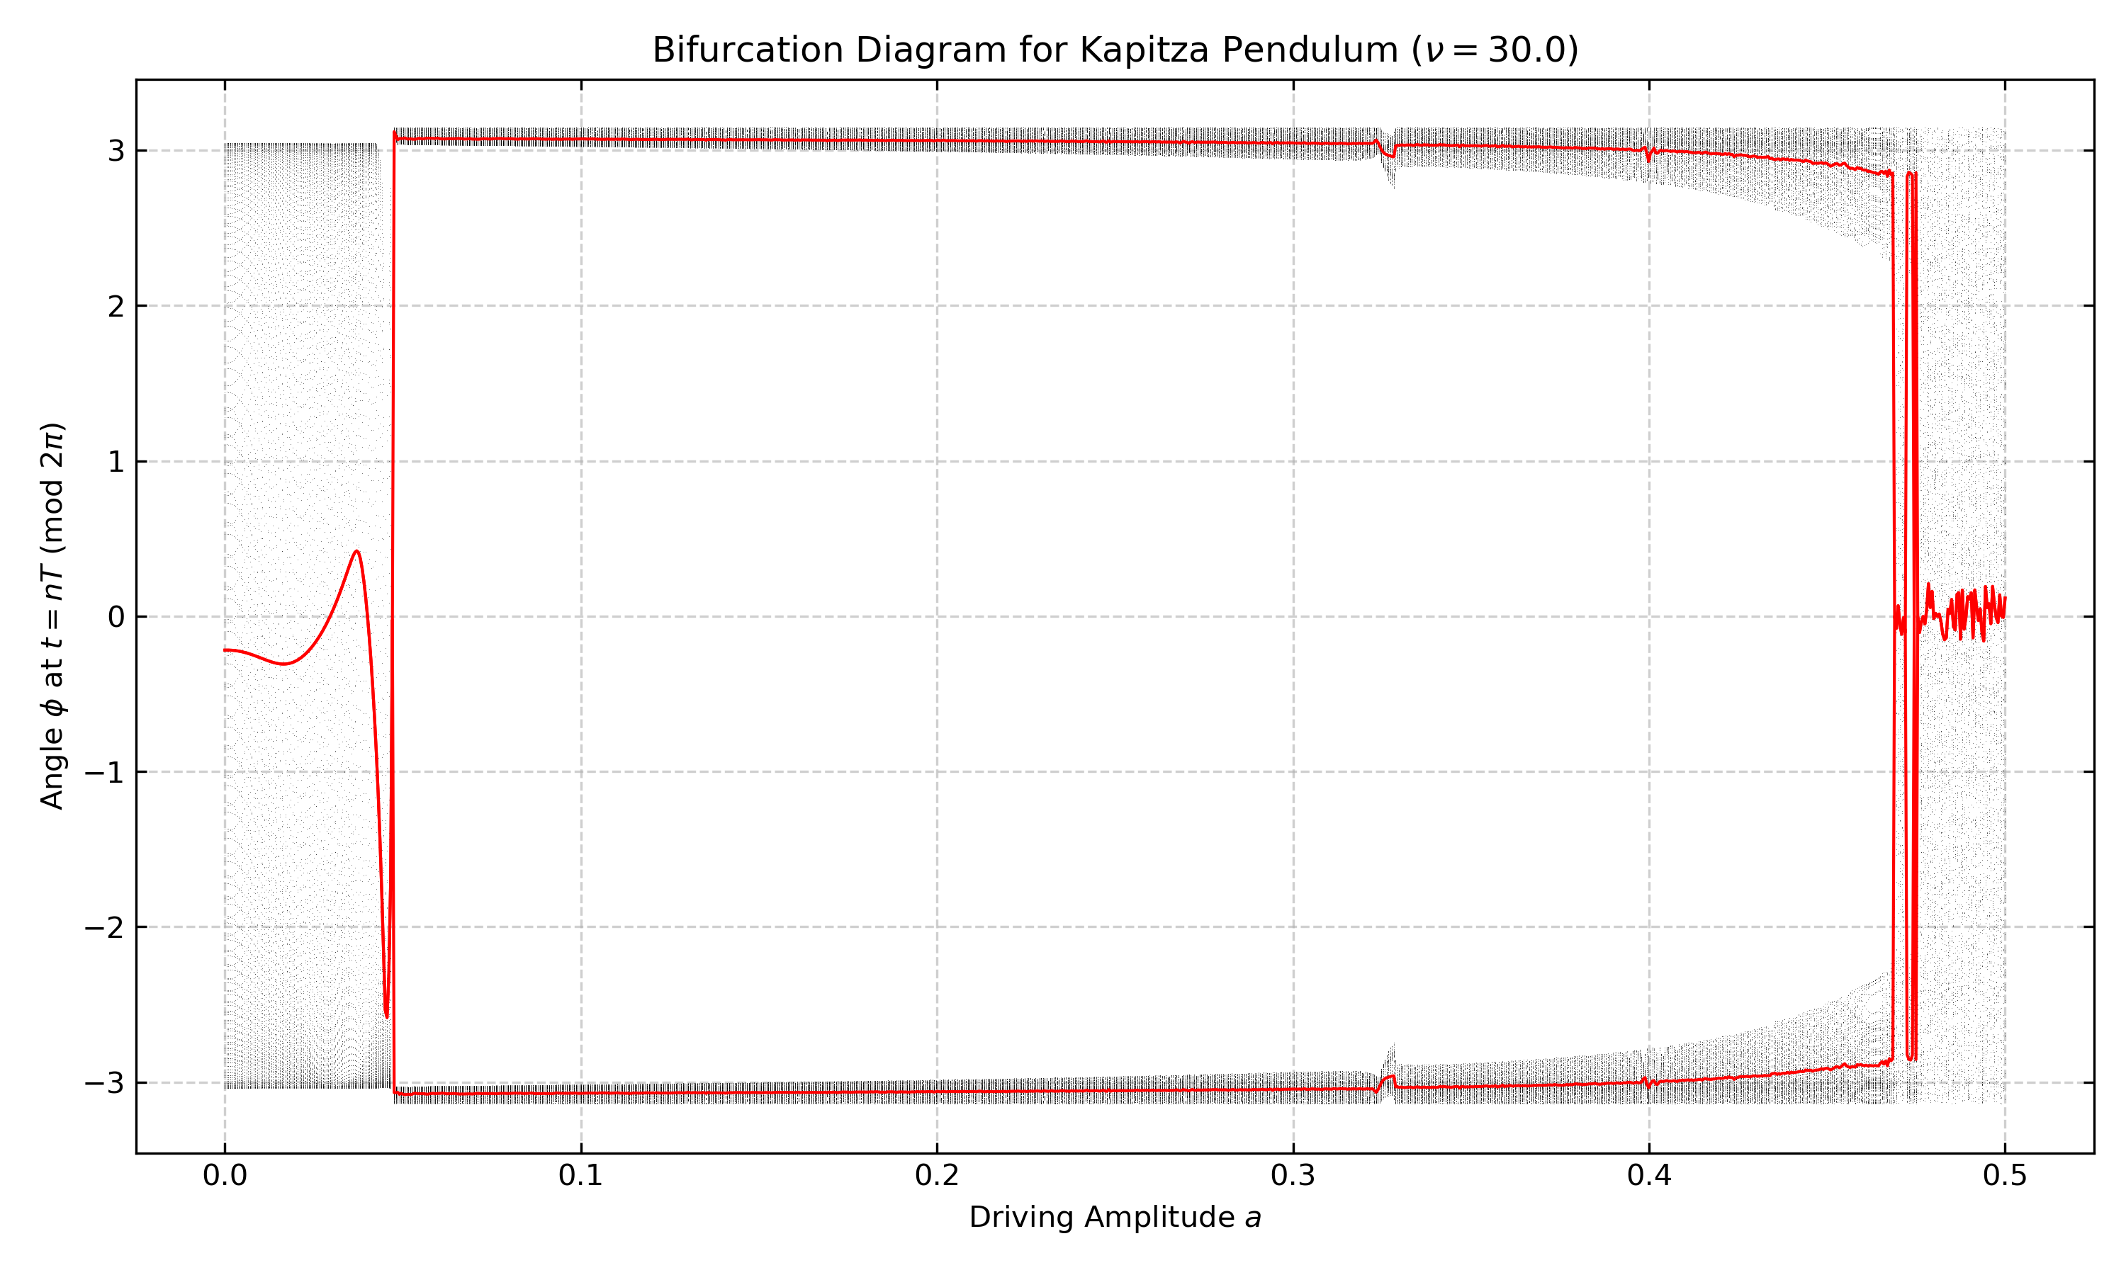

Slide 14
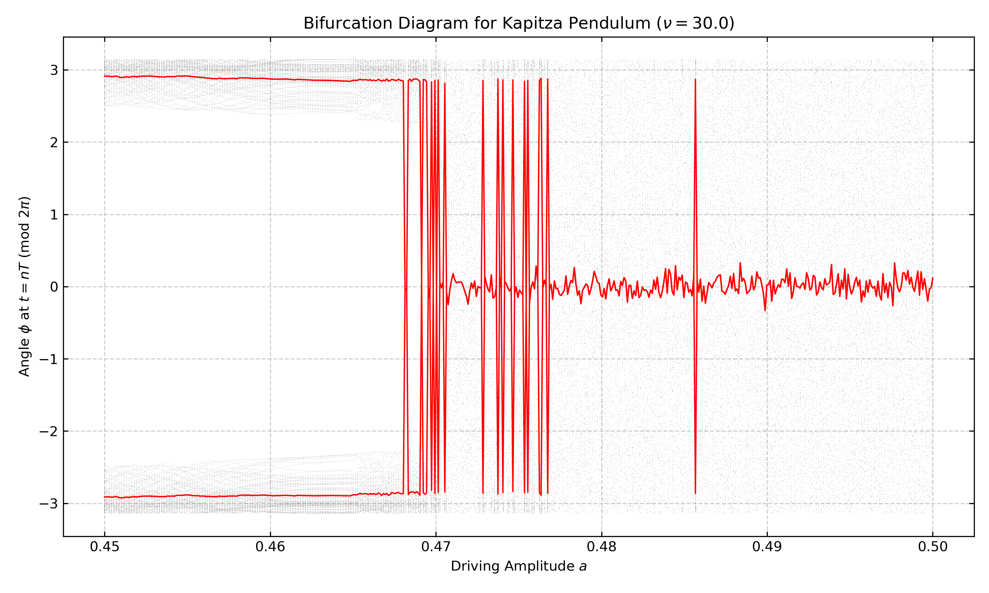

Slide 15
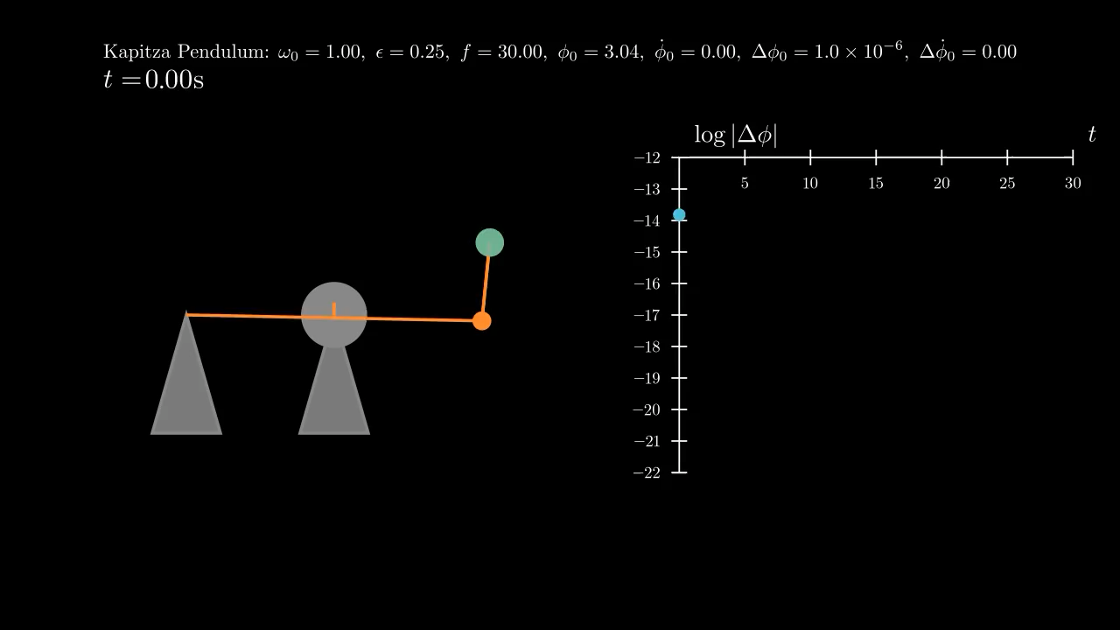

Slide 16
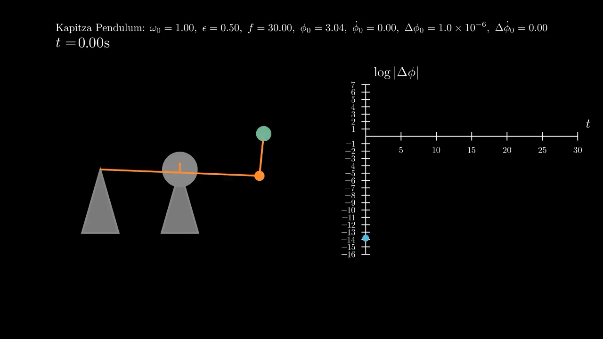

Slide 18
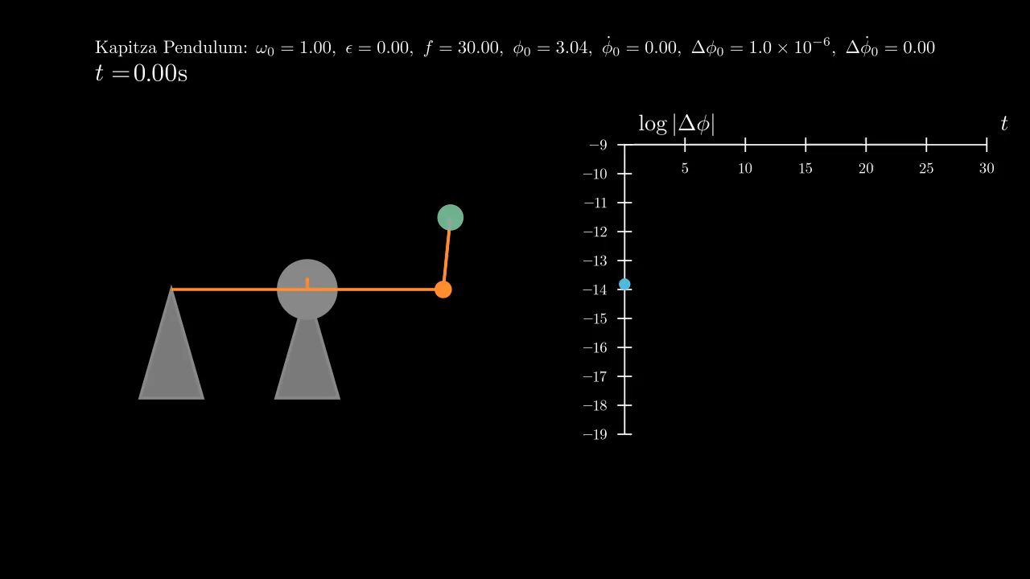

Slide 19
Further Work
Damping!
Further analysis!
Rotating solutions.
More chaos and bifurcations, more than stable pi equilibrium.
Hamiltonian and phase-space.

Slide 20
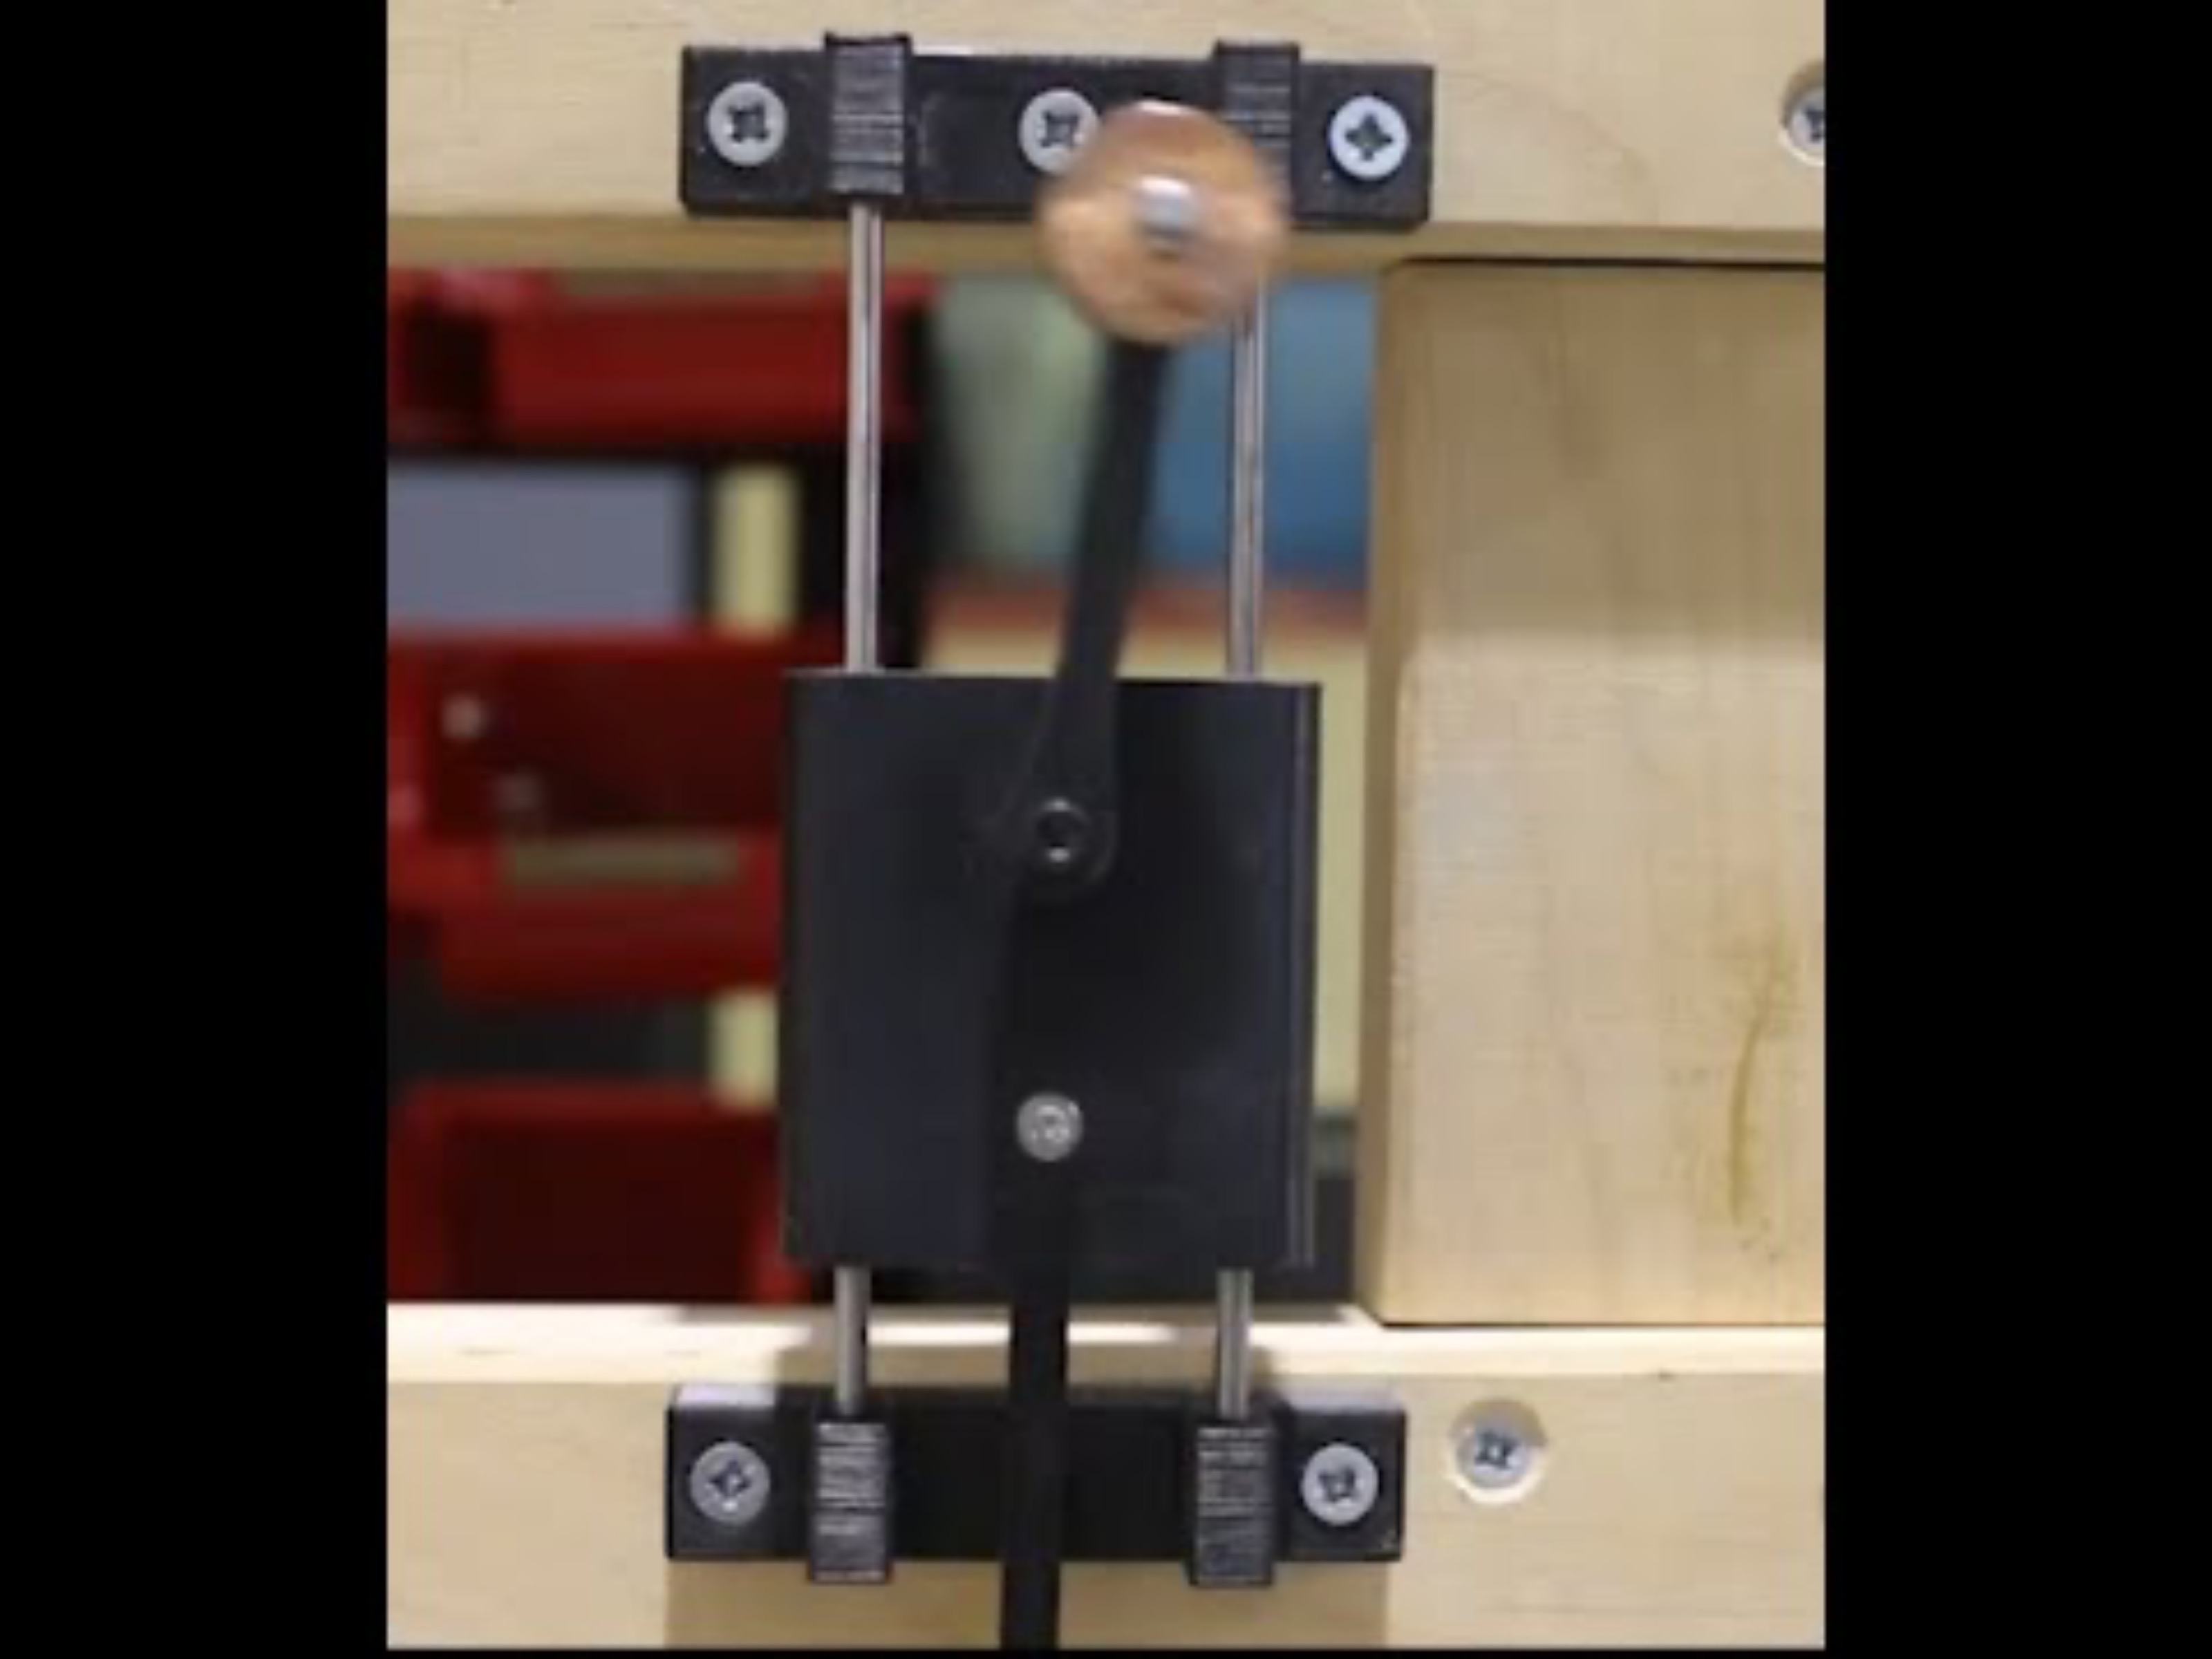
Demonstration
Video from Dynamics Uci on YouTube.
https://www.youtube.com/watch?v=GgYABmG_bto

Slide 21
Thank You!

